Slide 1

Indoor Furniture Placement Copilot for Optimal Design
Team 14
Instructor: Prof. Osama Alshaykh
Group member: Yongyi Xie

Slide 2
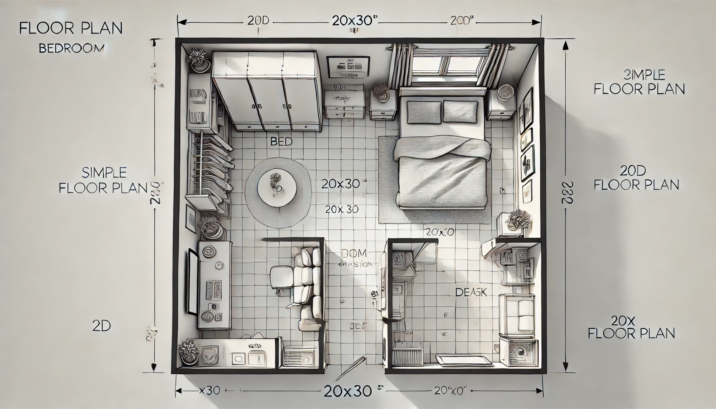
Design Problem
Background
Homes more intelligent and personalized, optimizing space for both aesthetics and functionality is essential
Large language models (LLMs) offer new opportunities for them
Mission Statement
Develop a tool that can give furniture placement plans based on safety and comfort
Fig.1 : Furniture plan designed directly by
ChatGPT prompts. Obviously it is not doing a good job. ☹

Slide 3
What have done so far since Sprint 3
Frontend
Created User windows for input
Backend
Furniture Placement Generation with modification
Clustering analysis for paths and find optimal solutions
Make use of OpenAI API

Slide 4
What to do next (Sprint 4, 5, …)
Implement backend
Improvements of optimization algorithms
Implement frontend
Add verbal prompts function
Try using other programming languages
Improve UI design for presentation
Put all things together

Slide 5
Challenges Facing
Hardware
Software

Slide 6
Project Schedule

Slide 7

THANK YOU!
xyy0208@bu.edu
https://github.com/van1dh/Indoor-Furniture-Placement-Copilot/tree/main

